Slide 1

6.870 Final Project
Webnnel: A channel-based Web navigation system
Chen-Hsiang Yu and Oshani Seneviratne
{chyu,oshani}@mit.edu
May 14, 2008
6.870 Multimodal User Interface

Slide 2

Outline
Introduction
Motivations
Related Work
Our Approach
Demonstration
Challenges & Future Work
Discussion
References
May 14, 2008
6.870 Multimodal User Interface

Slide 3
Introduction
The Web has become an important medium for delivering information.
  Checking e-mails
  Reading news
  Watching videos
  Listening to music
  Shopping on the Web
  . . .
People are familiar with using the Web, and start to apply similar experience to different domains.
  Mobile browsing
  Browsing on different Wi-Fi enabled devices
  . . .
May 14, 2008
6.870 Multimodal User Interface

Slide 4
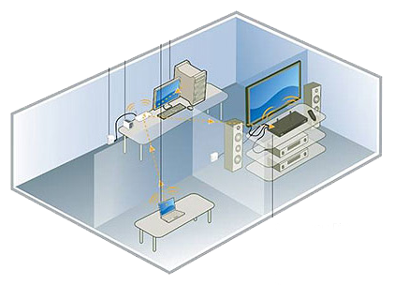
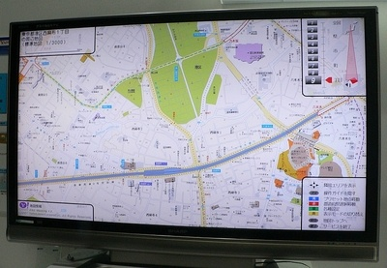
Motivations
However, we spend more than 40% of our time at home.
In this project, we envision an application of Web browsing for home environment.
On the other hand, in the near future, you will watch your TV program along with browse the Web and use Web applications.
Access and enjoy your digital entertainment easily on your TV and HDTV
May 14, 2008
6.870 Multimodal User Interface

Slide 5
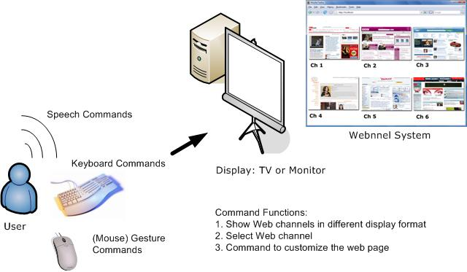
Motivations (cont.)
We propose to use multiple modalities to assist Web browsing at home environment.
Figure 1: The concept of the Web channel (webnnel) system.
May 14, 2008
6.870 Multimodal User Interface

Slide 6
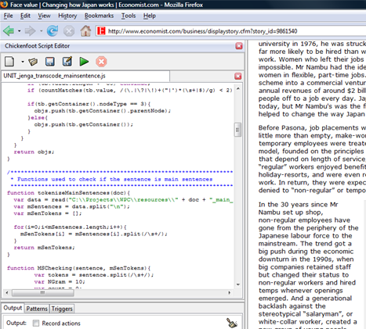
Related Work
Web automation and customization
  End-user programming for automation and customization on the Web
  Chickenfoot (Bolin et al. [3])
  GreaseMonkey [5]
Figure 2: Chickenfoot User Interface
May 14, 2008
6.870 Multimodal User Interface

Slide 7
Related Work (Cont.)
  Pre-defined tool-based customization
    Web Developer (Chris Pederick [X])
    Platypus (Scott R. Turner [X])
May 14, 2008
6.870 Multimodal User Interface

Slide 8
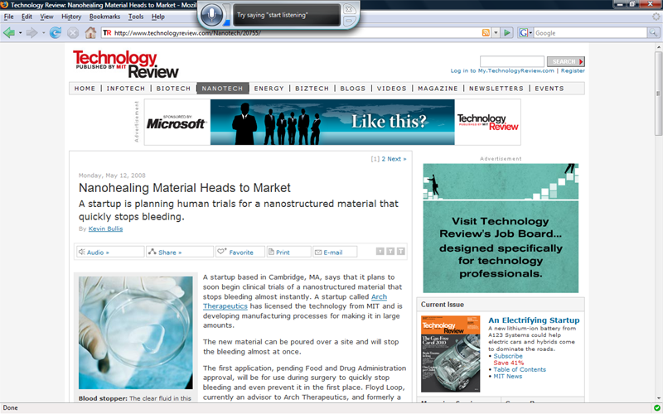
Related Work (Cont.)
Speech Recognition
  Microsoft Vista Speech Recognition Engine
  Apple Mac Speech Recognition Engine
  But none of the above provide the level of customization offered by Webnnel!
Figure 3: Microsoft Vista Speech Recognition
May 14, 2008
6.870 Multimodal User Interface

Slide 9
Our Approach
Design an integrated system with multiple modalities to help users access the Web on a bigger screen.
Webnnel system is composed of three sub-systems
  Webnnel Command System
  Speech Recognition System
  (Mouse) Gesture Recognition System
Because Web content is easier to access and control by the browser extension, we design our Webnnel Command System as a Firefox extension.
All the modalities, such as speech and (mouse, hand, head) gesture can use it to control the Web content.
May 14, 2008
6.870 Multimodal User Interface

Slide 10
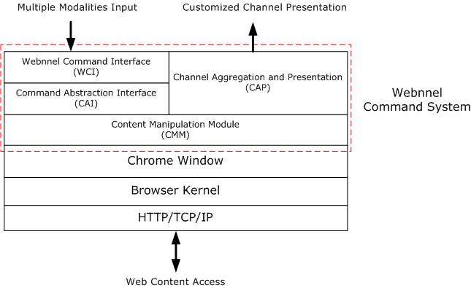
Our Approach - Webnnel Command System
Figure 4: The system architecture of the Webnnel system.
May 14, 2008
6.870 Multimodal User Interface

Slide 11
Our Approach - Webnnel Command System
Webnnel Command Interface (WCI)
  Provide a command interface between different modality engines and Webnnel command system.
Command Abstraction Interface (CAI)
  Define high level APIs for WCI to satisfy users’ commands.
Content Manipulation Module (CMM)
  Define functions for specific purpose, such as remove image, content transformation, etc, for CAI. Such as “my email” command.
  Define functions for CAP to render content, such as web site snapshots or displaying with different formats.
Channel Aggregation and Presentation (CAP)
  Provide web site snapshots rendering and UI supports.
May 14, 2008
6.870 Multimodal User Interface

Slide 12
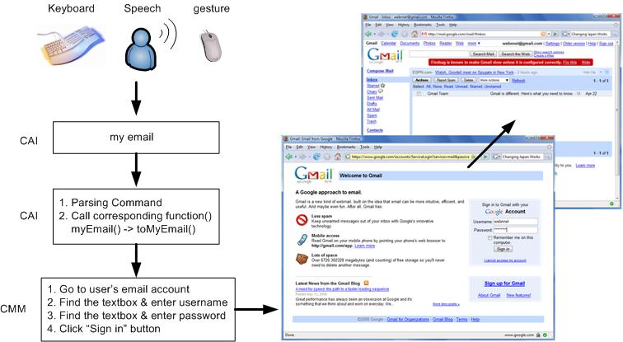
Our Approach - Webnnel Command System
Figure 5: The system architecture of the Webnnel system.
May 14, 2008
6.870 Multimodal User Interface

Slide 13
Our Approach - Speech Recognition
Used the Mac OS Speech Recognition Engine
Written in Objective C
Highly flexible
To add new commands you have to…
  Allocate and initialize an instance of NSSpeechRecognizer.
  Set the commands that the object should listen for using the setCommands: method.
  Set a delegate for the NSSpeechRecognizer object that implements the speechRecognizer:didRecognizeCommand
May 14, 2008
6.870 Multimodal User Interface

Slide 14
Our Approach - (Mouse) Gesture System
Used
May 14, 2008
6.870 Multimodal User Interface

Slide 15
Our Approach - Integration
Web Customization and Automation:
Apple Scripts:
  Acts as the “glue” between the speech recognition and the Webnnel Firefox Extension
  Custom scripts for each speech command
  Perform keystrokes at the Webnnel command prompt upon recognition
May 14, 2008
6.870 Multimodal User Interface

Slide 16
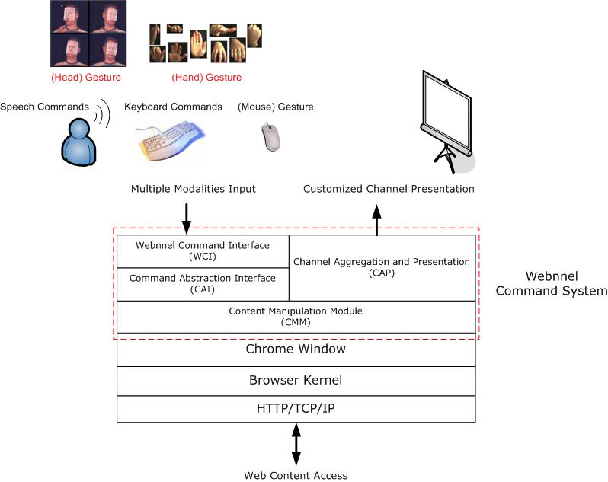
Our Approach - Integration (Cont.)
May 14, 2008
6.870 Multimodal User Interface

Slide 17
Demonstration
Webnnel Speech Recognition
Webnnel Command System
(Mouse) Gesture Recognition
May 14, 2008
6.870 Multimodal User Interface

Slide 18
Challenges
Early experimentation on CMU-Sphinx4 Java based speech recognition failed
  Too many configuration parameters to consider
  Our custom language model and grammar had a very poor recognition accuracy
Achieving cross platform compatibility:
  Compared to the Mac OS, Windows (XP, Vista) and Linux (Ubuntu 7.10) did not have good support for speech recognition.
  The quality of the microphones vary across different computers
Introducing many speech commands generally lowers the accuracy of the entire system
Having a stress ball around was very handy while testing the speech recognition :)
May 14, 2008
6.870 Multimodal User Interface

Slide 19
Future Work
Enhance the UI of Webnnel Command System
  Add / Delete Web channels
  Add / Delete / Modify E-mail account information
Integrate other modality input, such as hand gesture and head gesture.
Conduct user study to know the feedback from the user.
Porting the speech recognition aspect of the Webnnel system to other platforms.
May 14, 2008
6.870 Multimodal User Interface

Slide 20
Discussion
Why command system works?
Speech recognition
Interface between different application and the browser
Mouse gesture recognition
May 14, 2008
6.870 Multimodal User Interface

Slide 21
References
Avot mV, http://www.avotmedia.com/
Bigham, J. P., and Ladner, R. E. Accessmonkey: a collaborative scripting framework for web users and developers. In W4A '07, ACM Press, pp. 25-34, 2007.
Bolin, M., Webber, M., Rha, P., Wilson, T. and Miller, R.C. Automation and customization of rendered web pages, Proceedings of the 18th annual ACM symposium on User interface software and technology, October 23-26, 2005.
CMU-Sphinx Speech Recognition Engine, http://cmusphinx.sourceforge.net/html/cmusphinx.php
Greasemonkey, https://addons.mozilla.org/en-US/firefox/addon/748
Joost, http://www.joost.com/
Microsoft Windows Vista Speech Recognition system http://www.microsoft.com/enable/products/windowsvista/speech.aspx
Mogulus, http://www.mogulus.com/
Petrie, H., Hamilton, F. and King, N. Tension, what tension? Website accessibility and visual design. Proceedings of the 2004 international cross-disciplinaryworkshop on Web accessibility (W4A), pp. 13-18, 2004.
May 14, 2008
6.870 Multimodal User Interface

Slide 22
References (cont.)
Richards, J. and Hanson, V. Web accessibility: a broader view. Proceedings of the 13th international conference on World Wide Web, pp. 72-79, 2004.
May 14, 2008
6.870 Multimodal User Interface

Slide 23
Any Question?
{chyu,oshani}@mit.edu
May 14, 2008
6.870 Multimodal User Interface

